Slide 1


Git and Version Control
lmichiel@exseed.ed.ac.uk

Slide 2



@EdCDCS
For all events, news, and support: cdcs.ed.ac.uk

Slide 3

Feedback and CDCS Peer Learning Cohorts
This series of trainings depend on annually allocated founds!!! To secure them we need to provide detailed feedback on them
More on the Peer Learning Cohorts
https://www.cdcs.ed.ac.uk/training/cdcs-peer-learning-cohorts
https://bit.ly/2qojndq

Slide 4

Git and Version Control
Who are we?
Why are we here?
Why do you want to learn Git and Version Control?

Slide 5
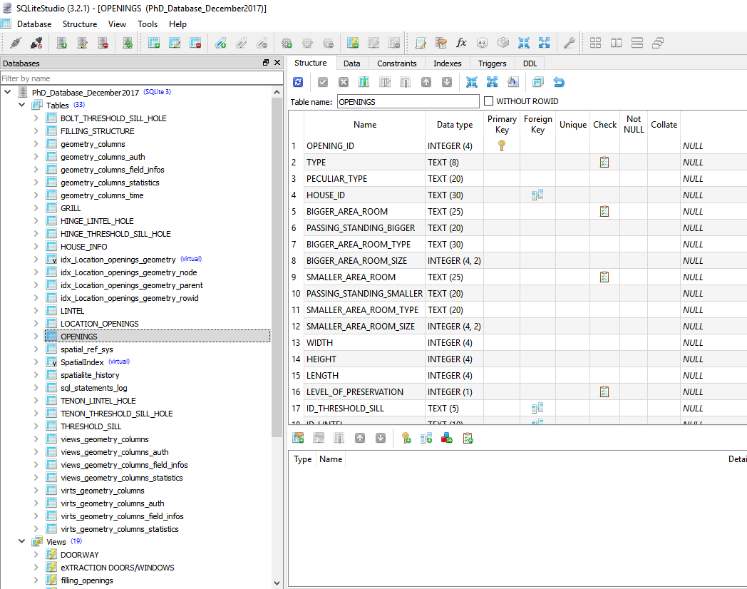
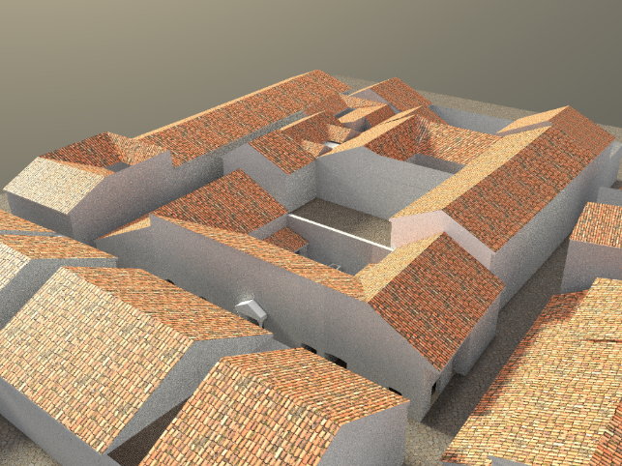
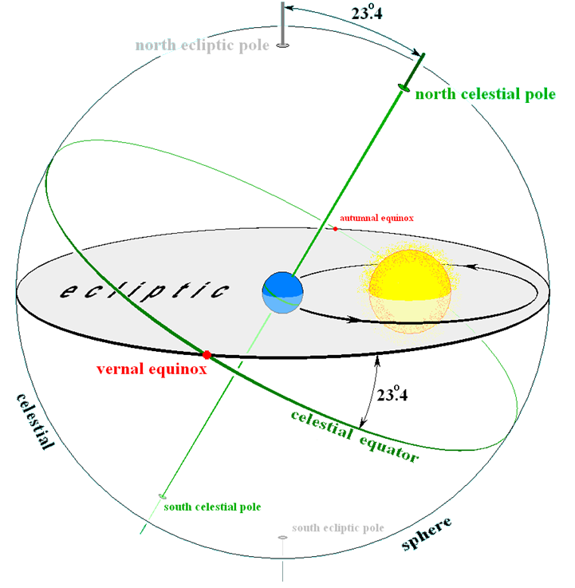
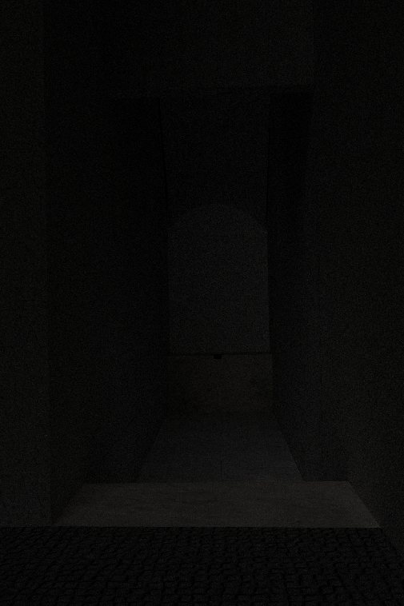
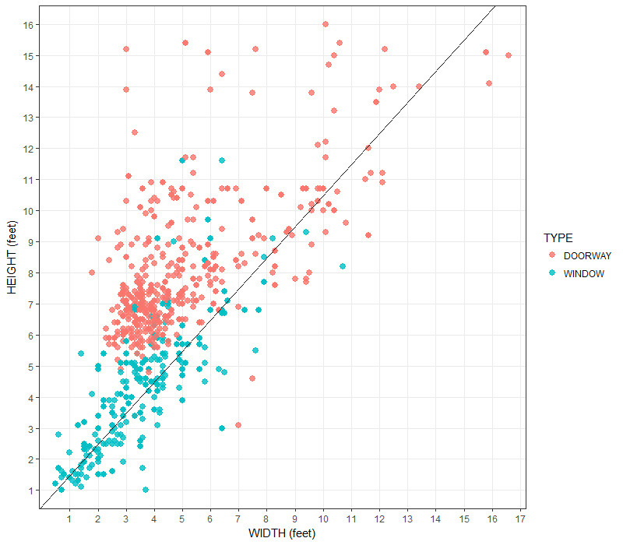
Before starting …
Who am I
I obtained a Phd in Classic from UEd
Training Fellow with DCS
Db Developer for the DBL project

Slide 6
Git and Version Control Structure of the course
First part: Today and next 2 Friday
Introduction to Git and version control
Structure of the module: Videos and hands on exercises
Question time and feed-back (last 10 mins)
https://www.linkedin.com/learning/git-essential-training-the-basics/use-git-version-control-software-to-manage-project-code?u=50251009
Second part: Fridays (20, 27 of March)
Working with Github and GitLab
Structure of the module: Videos and hands on exercises
Question time and feed-back (last 10 mins)

Slide 7
Today program
What is Git? And what is Version Control? Why and when shall I use it?
Install Git on your machine
What is a command line
Getting start with the Git environment

Slide 8
Git and Version control
Version Control
The history behind Git
About distributed version control

Slide 9

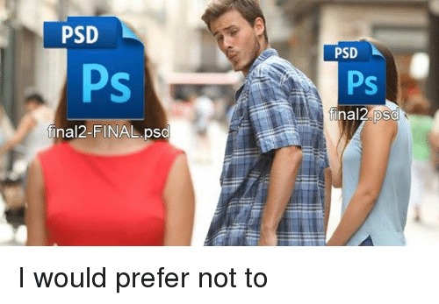
What is Version Control?
“A component of software configuration management, version control, also known as revision control or source control, is the management of changes to documents, computer programs, large web sites, and other collections of information. Changes are usually identified by a number or letter code, termed the "revision number", "revision level", or simply "revision". Each revision is associated with a timestamp and the person making the change. Revisions can be compared, restored, and with some types of files, merged.” Wikipedia
Do you think you ever use it? In which context?

Slide 10

The history behind Git?
SCCS (Source Code Control System) 1972 UNIX only
RCS (Revision Control System) 1982 Cross Platforms
CVS (Concurrent Version System) 1986-1990 Multiple files and Multi users
SVN (Apache Subversion) 2000 Track images too, Track directory collectively
BitKeeper SCM 2000 Close source

Slide 11
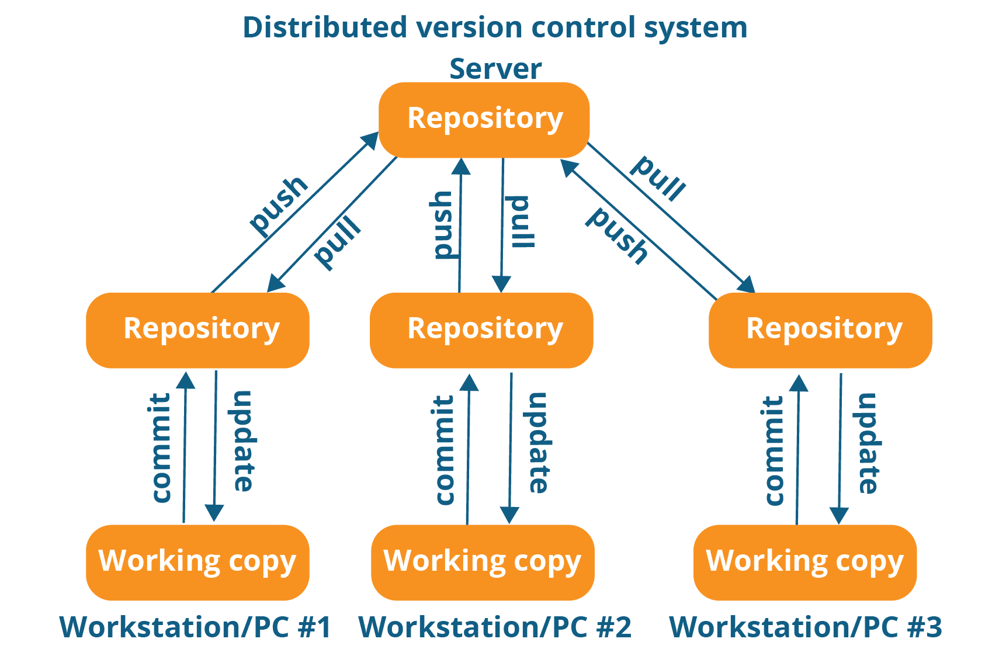
Distributed Version Control?
Centralised Vs Distributed

Slide 12
Comand Line
What is a command line
Command line options

Slide 13
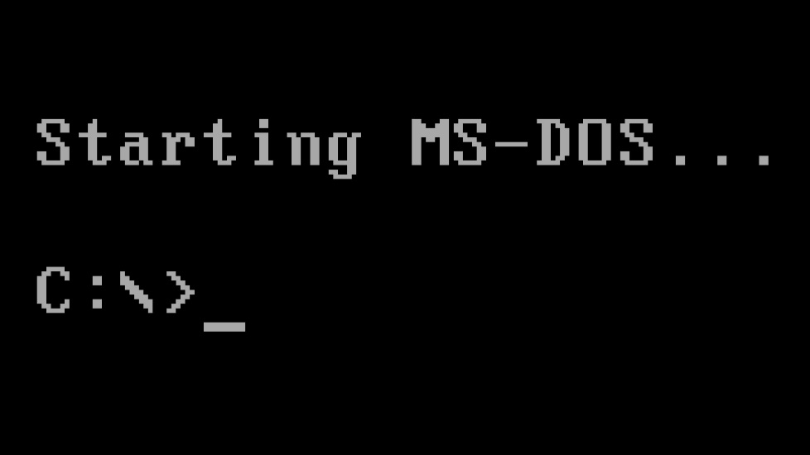
https://www.davidbaumgold.com/tutorials/command-line/
What is a Command line?
Command-line interface (CLI) processes commands to a computer program in the form of lines of text. The program which handles the interface is called a command-line interpreter or command-line processor. Operating systems implement a command-line interface in a shell for interactive access to operating system functions or services.

Slide 14
Command line Options?
Windows
Powershell. Type it on Search and run it at administrator
Comand prompt (often linux command not working)
To be sure everything is working you can use the bash (you find it in the bin folder)
Mac OS X
Terminal (/application/Utilities/ folder)
Linux
If you are using KDE, click the K button, select System, and click on Konsole
If you are using Gnome, click the Applications button at the top left, select System Tools, and click on Terminal.

Slide 15
Install Git
Install Git on Mac
Install Git on Windows
Install Git on Linux
Basic Configuration
Git Auto-Completion
Git Help

Slide 16

Install Git
Mac OS X
https://git-scm.com/download/mac
Open .dmg file
When you open the package it gives an error
Hold Control key while clicking on it and select Open with Installer
Eject the .dmg file as you would do with an pendrive
Go to application -> Utility -> Terminal
Comand: which git (where is the git software) or where
Comand : git –version (which version do you have)

Slide 17
Install Git
Window
https://git-scm.com/download/win
Open the installer
Follow the path installer
Just accept the default options
Choose the editor you want to use (Nano, Notepad ++ etc)
If you are on windows 10 select Windows default console window
Go to search and type either ‘Command prompt’ or ‘Powershell’. Right click of the mouse if you want to use them as administrator
Comand: which git (where is the git software) or where
Comand : git –version (which version do you have)

Slide 18
Install Git
Linux
https://git-scm.com/download/linux
Follow the instruction pertinent on your version
Go to command line
Comand: which git (where is the git software) or where
Comand : git –version (which version do you have

Slide 19

Basic Configuration
Set a series of Basic Configuration to make your life easier
Set your username and mail
git config --global user.name “Your Name”
git config --global user.email “your mail”
git config --list
git config user.name
git config --global core.editor “”
git config -- global color.ui true
cat .gitconfig to see what config have been set
https://en.wikibooks.org/wiki/Guide_to_Unix/Commands/File_System_Utilities
System Level (all users)
git config --system
User Level
git config --global
Project Level
git config

Slide 20
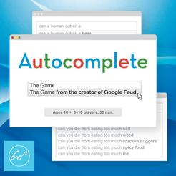
Git Auto-complete
if [ -f ~/.git-completion.bash ]; then
source ~/.git-completion.bash
fi
Already set for Windows: just press tab
Go to github.com/git/git
Go to contrib/completion
Download or copy paste git-completion.bash on your home directory
mv git-completion.bash .git-completion.bash (to rename it as a .file)
Open .bash_profile with your text editor: nano .bash_profile
Past the code
Crt x, Y

Slide 21

Git Help
At any point you can call the manual of the command you are trying to use
git help “the command you want to know more about it”
Or
man git “something”

Slide 22
Getting Started with Git
Initialise a repository
Where Git files are stored
Your first commit
Write a commit message
View the commit Log

Slide 23
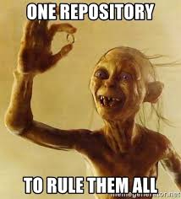
Initialise a repository
Create a folder that will contain all your documents
Navigate to the newly created folder
Be sure to be inside the directory created
Git init
Do a ls –la to see the .git file
git init

Slide 24
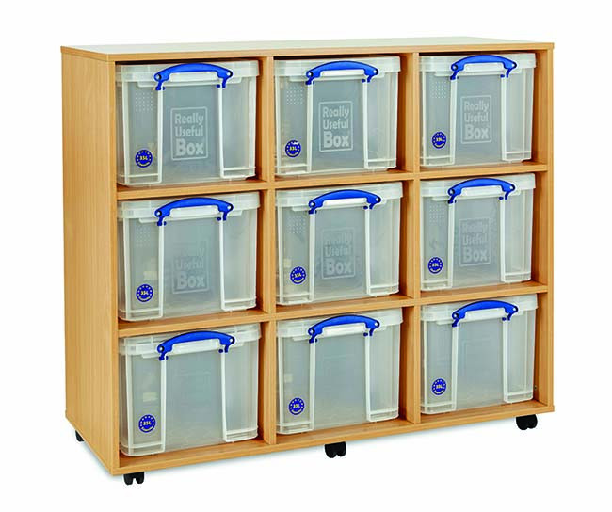
Where Git files are stored
To view what is inside the .git folder created by git init
Ls –la .git
Cat .git/config (see what is inside the config file)
Configure the .config file if you want specific configurations for that project only (either via command git config etc… or by open the .config file with a text editor)
NB this directory is the tracking if you cancel it you cancel git from the project

Slide 25
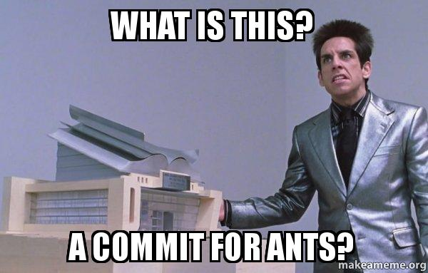
Your first Commit
Create a new document with a text editor not a word processor
You can do it directly with nano from the shell
git add . (current directory)
git commit –m “write a commit message”
Make changes
Add the changes
Commit the changes with a message

Slide 26
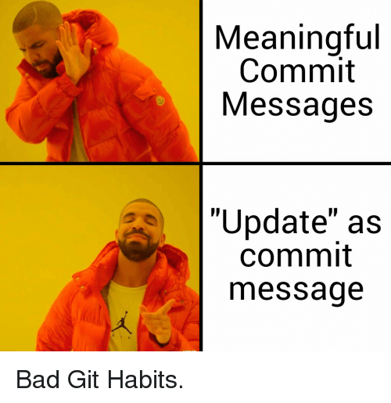
Write a commit message
Golden rules to write a commit
A short single-line summary (less than 50 characters)
Option to enter a blank line and then more complete description
Keep each line to less than 72 characters (for cross device compatibility)
Write commit message in present tense (improve comprehension)
Be Clear and Descriptive
NB: “Add a new file is not a good commit message”

Slide 27
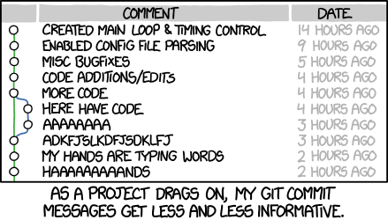
View Commit Log
Log id: unique identifier of that commit
Author: You if you set the configure correctly
Date: timestamp on when it happened
Message: the message you write
git log –n 5(last 5 commits)
git log --since=2020-01-01 (since when)
git log --until=2020-01-01 (until when)
git log --author=“Lucia” (your name or part of it)
git log --grep=“Init” (containing that letters)
git log:

Slide 28

Any Questions?

Slide 29
Next Class
Git Concepts and Architecture
Make changes to files
Use git on a real project

Slide 30
Today program 05/03/2020
Git Concept and Architecture
Make changes to files
Use git on a real Project

Slide 31
Git Concept and Architecture
The three trees
Git workflow
Hash values (SHA-1)
The HEAD pointer

Slide 32
The three trees
Standard Version control system
Git architecture
repository
repository
1
1
checkout
git commit
commit
Working copy
Staging index
2
2
git
checkout
git add
Working copy
3

Slide 33
Git Workflow
repository
A
repository
A B
repository
A B C
git commit
git commit
git commit
Staging index
Staging index
Staging index
File.txt (v1) - A
File.txt (v2) - B
File.txt (v2) - C
git add
git add
git add
Working copy
Working copy
Working copy
File.txt (v1) - A
File.txt (v2) - B
File.txt (v2) - C
A B C = set of changes /commits

Slide 34
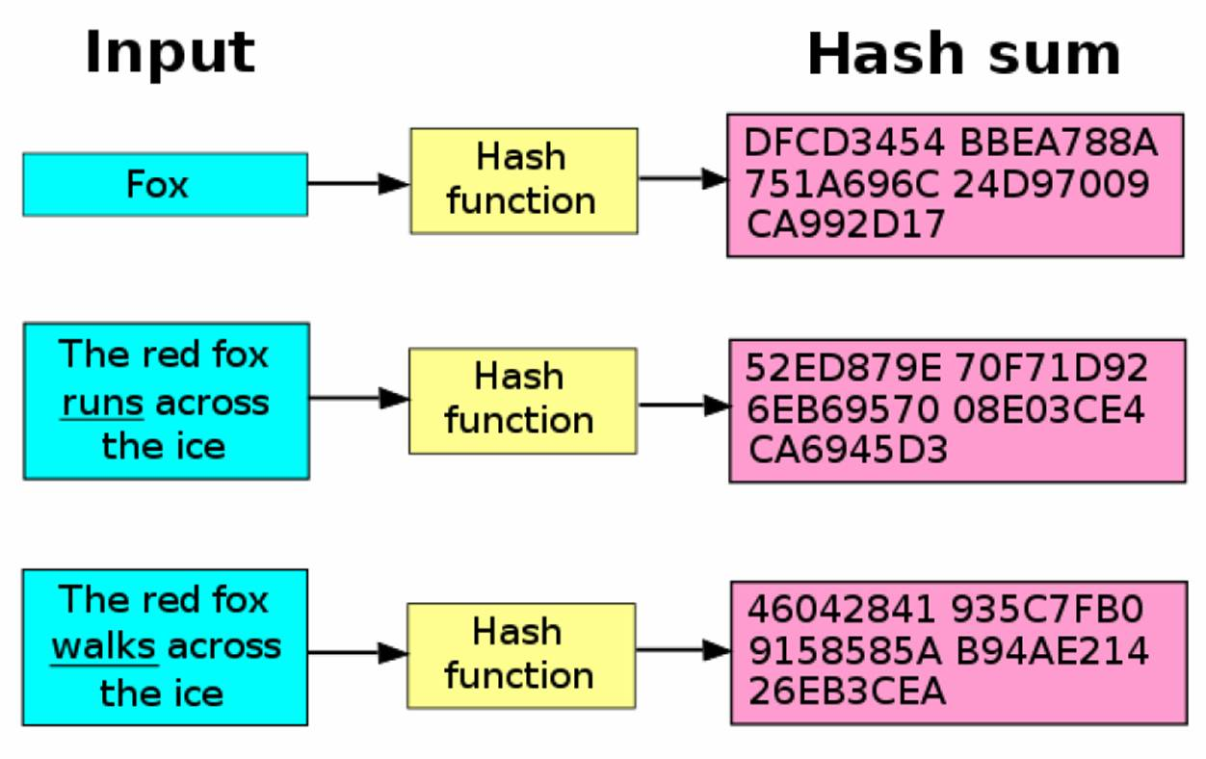
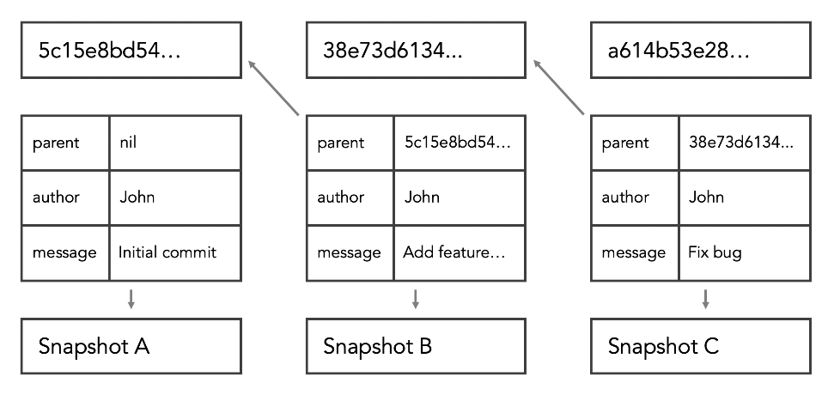
Hash Values (SHA -1)
Unique identifier SHA Value of that specific set of changes and the person that commit and the log message written
40 characters long
Hash values can be thought of as fingerprints for files. The contents of a file are processed through a cryptographic algorithm, and a unique numerical value – the hash value - is produced that identifies the contents of the file. If the contents are modified in any way, the value of the hash will also change significantly. Two algorithms are currently widely used to produce hash values: the MD5 and SHA1 algorithms.

Slide 35
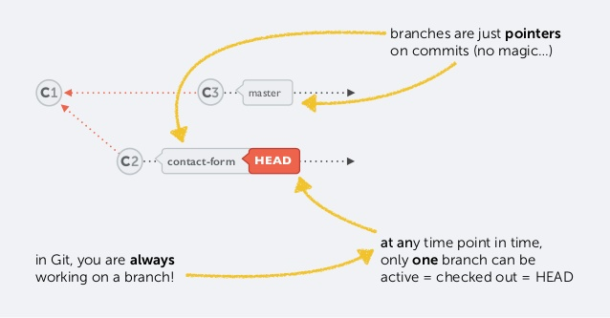
Head Pointer
HEAD is a reference to the last commit in the currently check-out branch.
You can think of the HEAD as the "current branch".
When you switch branches with git checkout, the HEAD revision changes to point to the tip of the new branch.
You can see what HEAD points to by doing:
cat .git/HEAD
cat .git/refs/heads/master

Slide 36
Make Changes to Fiels
Add files
Edit files
View changes with diff
View only staged changes
Delete files
Move and rename files

Slide 37
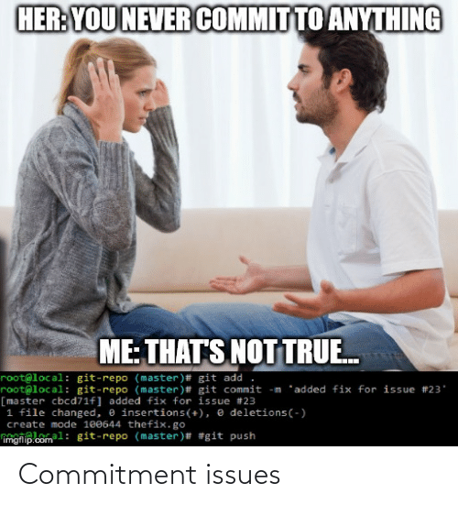
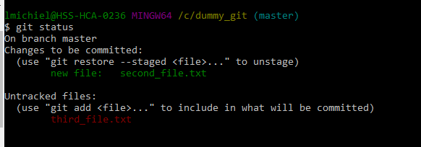
Add file
You can check the status of your repo by doing:
git status
git add <your file>
git commit <your file>
For any new files added

Slide 38
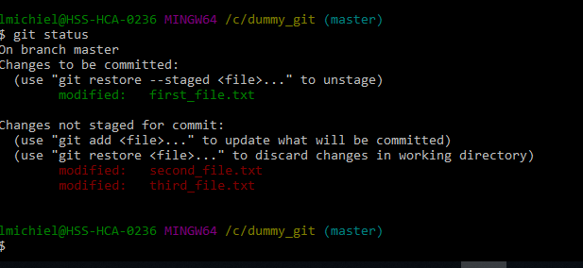
Edit files
You can check the status of your repo by doing:
git status
git add <your file>
git commit <your file>
For any new files changed

Slide 39
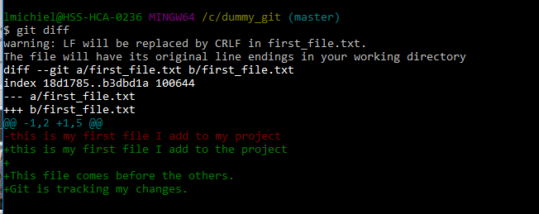
View changes with git diff
You can check the status of your repo by doing:
git status
git diff (to compare the changes across 2 version of the same file)
a= the file committed in the repo
b= the file in the working directory
-=what is in the repo file
+=what is in the working directory file

Slide 40
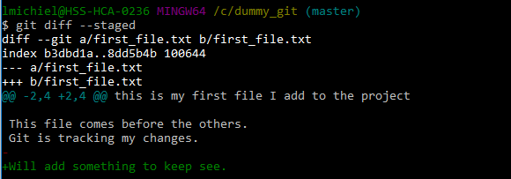
View only staged changes
You can check the status of your repo by doing:
git status
git diff --staged /git diff --cached(difference between what is staged and what is on the repo)
a= the file committed in the repo
b= the file in the working directory
-=what is in the repo file
+=what is in the working directory file

Slide 41
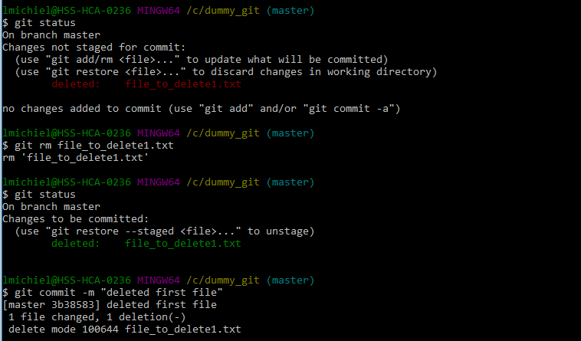
Delete files
To delete files there are 2 ways
Version 1
Manually delete it
git rm <name file>
git commit -m “deleted the x file”
Version 2
git rm <name file>
git commit -m “deleted the x file”
NB: with the second option you will not find the file in the bin

Slide 42
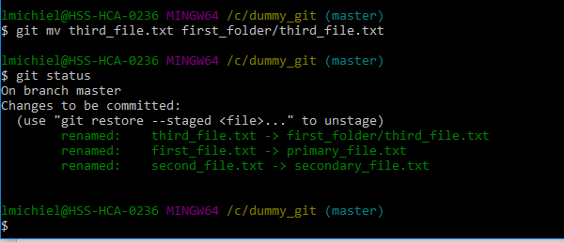
Move and rename files
To rename files there are 2 ways
Version 1
Manually rename it
git add<new name file>
git rm <oldname file>
git status
git commit -m “deleted the x file”
Version 2
git mv <old name file> <newdirectory/new name file>
git commit -m “deleted the x file”
NB rename and move a file are basically the same for the computer

Slide 43
Use Git with a Real Project
The Explore California website
Initialise Git
View file edits
Stage and commit shortcut
View a commit
Compare commit
Multiline commit messages
Make atomic commits
Challenge: Client edit

Slide 44

The Explore California Website
Go to Exercise files
Download the zip file
Extract the Explore California folder to where you want to initialise the repo
Explore the folder
Go to index.html to see the demo of the website

Slide 45
Initialize Git in the new folder
Navigate to the newly created folder
Be sure to be inside the directory created and not in a sub directory
git init
Do a ls –la to see the folder and files init
git add .
git commit –m “initial commit”
git status
git init

Slide 46
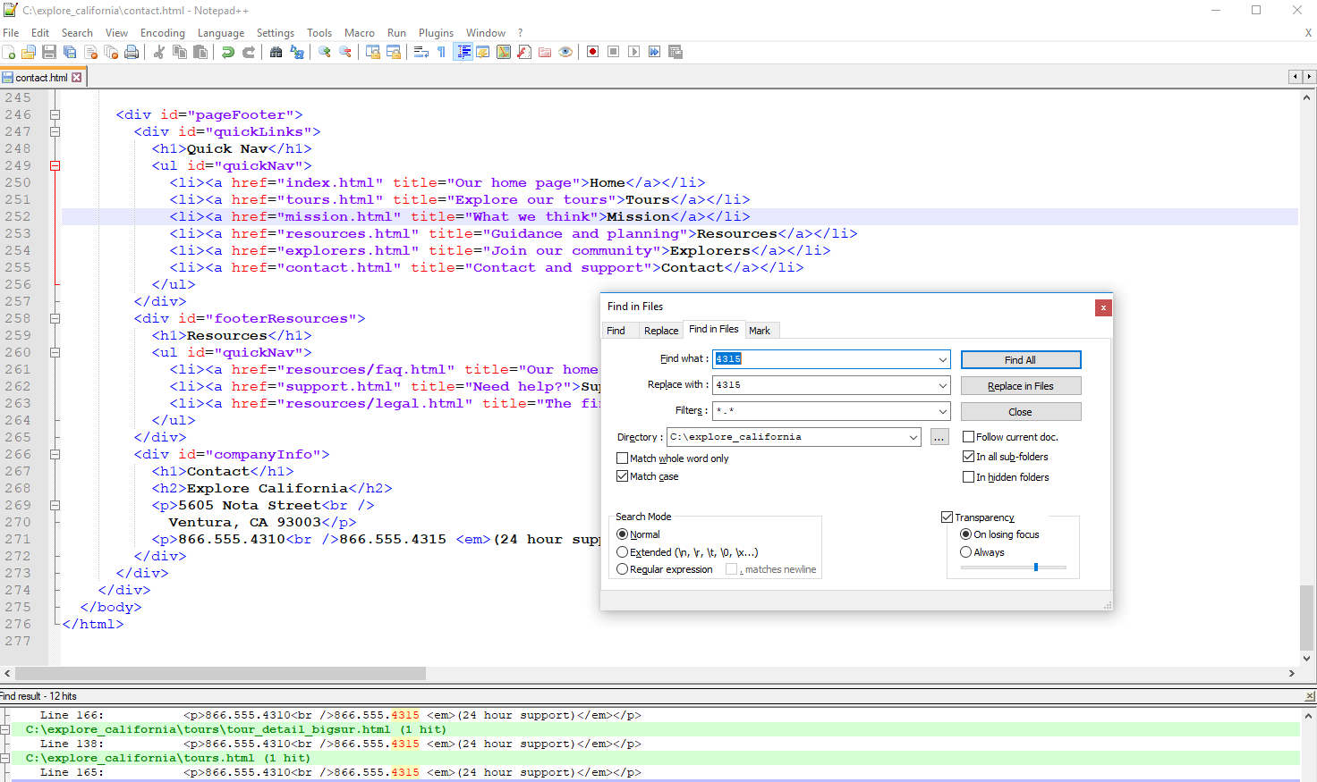
View file edits
Use your text editor to search and replace something from all files in your directory
Save all to save changes in all files
Check the .html file for the changes
Git status
Git diff (use space bar to go through the different changes and b and f to go back and forward)
Option: git diff --color-words to see better the changes
Press q to get off the git diff

Slide 47
Stage commit shortcuts
You can compress git add and git commit into 1 action:
git commit -am “ git commit message”
This only if you are sure you wan to commit all changes to track files
It does not include untracked files
NB you shall use it only if you are sure you want to commit all changes and you do not have untracked files
repository
1
git commit –am “edits support…”
Staging index
2
Working copy
3

Slide 48

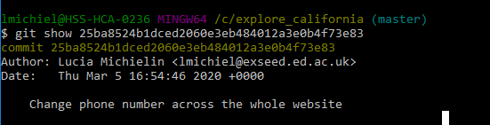
View a commit
Review changes on a later time
Make some changes and commit them
git show <sha code> (either crt c crt v or start type and autocomplete) – it give a diff as result (the option --color-words works in here too)

Slide 49

Compare commit
What if I want to compare different commits
git diff (--color-words) <sha code eldest commit>..<sha code newest commit)
Option to use HEAD as second comparison if I want to use where HEAD is (aka last commit)

Slide 50
Any Questions?

Slide 51
Next Class
Use git on a real project
Undo Changes
Ignore Files

Slide 52
Today program 13/03/2020
Use git on a real project (continue)
Undo Changes
Ignore Files

Slide 53
Use Git with a Real project (continue
The Explore California website
Initialise Git
View file edits
Stage and commit shortcut
View a commit
Compare commit
Multiline commit messages
Make atomic commits
Challenge: Client edit

Slide 54

Multiline commit messages
It is a good practice to have multiline commit message if you need to store many info within
git commit –a (and save text on the text editor)
git add + git commit (and save text on the text editor)

Slide 55
Make atomic commits
Small commits
Only affect a single aspect
Easier to understand, to work with, and to find bugs
Improve collaboration

Slide 56

Challenge: Client edits
Make changes and track them:
Change price of Big Sur Retreat from $620 to $750
Change price of California Calm from $250 to $270
Change title of Explorers page to “Make new friends”

Slide 57
Undo Changes
Undo working directory changes
Unstage files
Amend commits
Retrieve old versions
Revert a commit
Remove untracked files

Slide 58

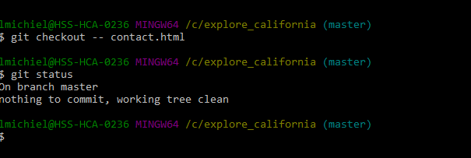
Undo working directory changes
You made a mistake and you want to revert to the previous version of a file
git diff (to see the differences)
git checkout -- <name of the file>

Slide 59
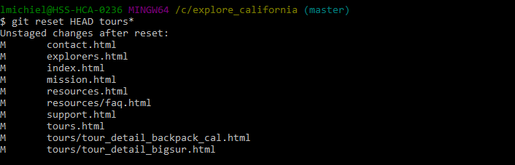
Unstage files
You made a mistake and you want to revert to the previous version of a file
git status (to see the differences)
git reset HEAD <name file>

Slide 60
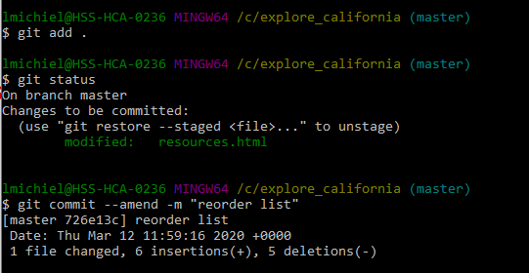
Amend commits
You can edit your last commit but not the previous ones
Make the changes you forgot
Git add .
Git commit --amend –m “reorder items”

Slide 61
Retrieve Old Versions
You can retrieve back to changes present in certain commits
git log
git show <sha>
git checkout <previous sha> -- <the file you want>
git status (now in staging directory)
git diff --staged
Make the changes you want
git status
git add
git commit

Slide 62
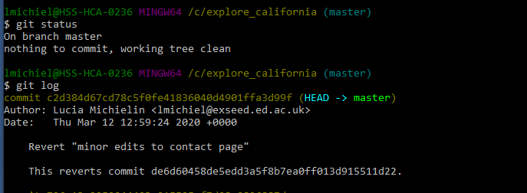
Revert a Commit
You can revert to any point in the repo by doing
git log (identify the sha you want to revert to)
git revert <name of the sha>

Slide 63
Remove untracked files
When you have untracked files that I do not want:
git clean –n (what it would do)
git clean –f (remove them)
NB they shall not be in the stage level otherwise it would not work

Slide 64
Ignore files
Use .gitignore files
Ideas on what to ignore
Globally ignore files
Ignore tracked files
Track empty directories

Slide 65
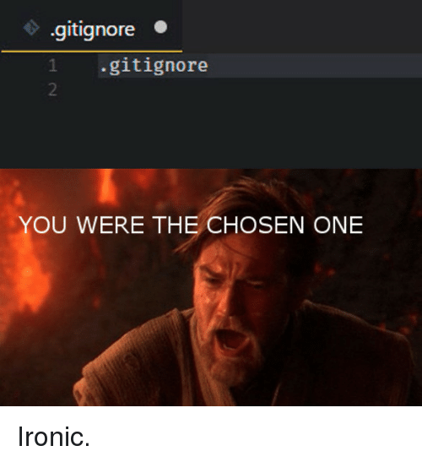
Use .gitignore files
What if we do not want to track changes of some files like .log files
Files
Pattern marching (regex) eg logs/*.txt
Negative expression (!)
All files in directory (trailing slash)
You can add comments (#)

Slide 66

Ideas on what to ignore
What shall I ignore
Compiled source code
Packages and compressed files
Logs and databases
Operating system generated files
User –uploaded assets ( images, pdf etc..)
Git ignore template at https://github.com/github/gitignore

Slide 67
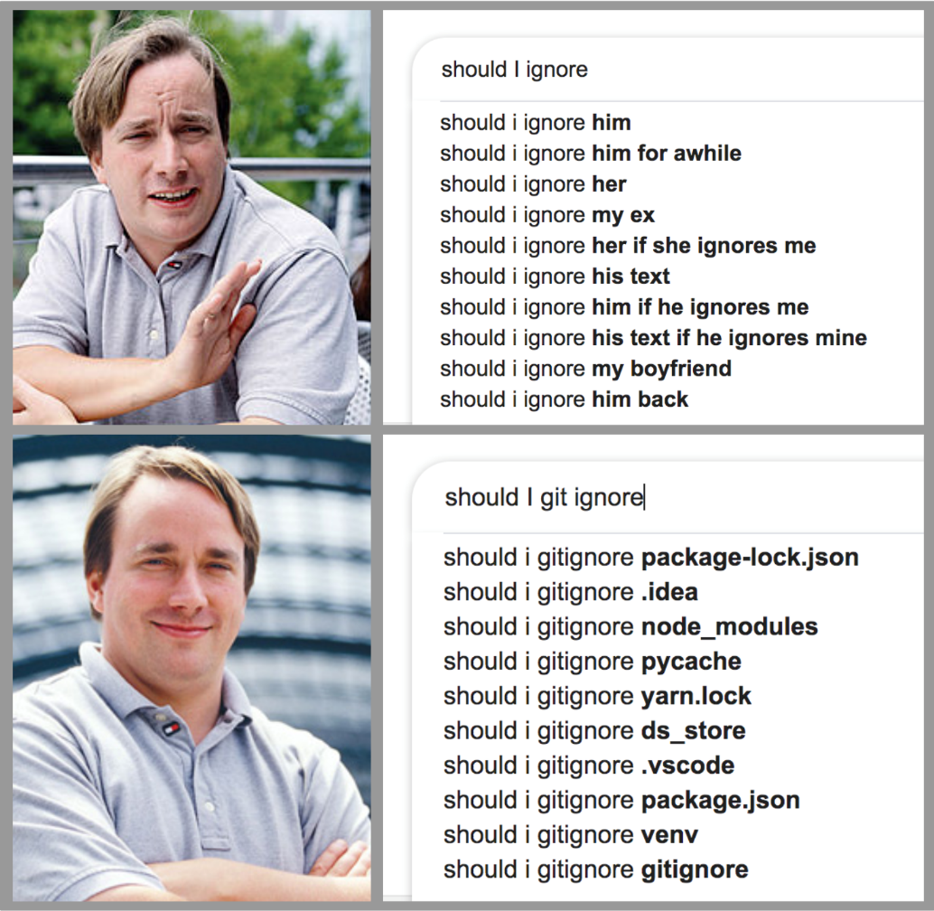
Globally ignore files
Ignore files in all repo = ignore file globally
git config --global core.excludefiles ~/.gitignore_global

Slide 68
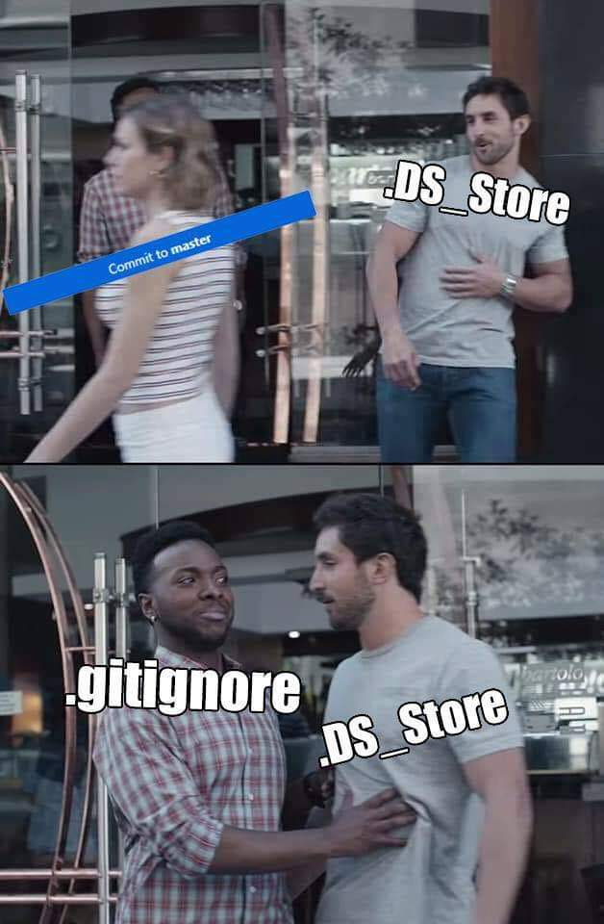
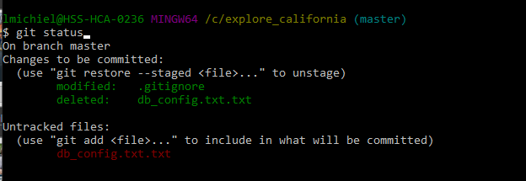
Ignore tracked files
What if files are already been tracked but I do not want to keep commit them
git rm --cached db_config.txt

Slide 69
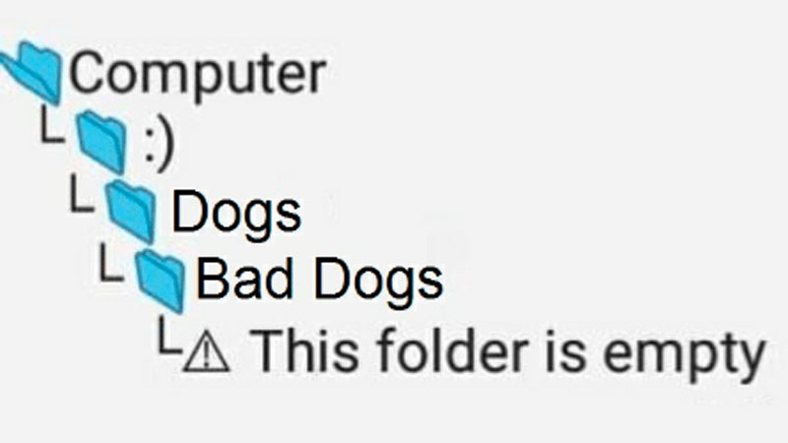
Track empty directories
Git ignore empty folders
git ls-tree HEAD (you do not see the empty dir)
Add a dot file: .gitkeep
touch <dir>/.gitkeep

Slide 70
Next Class Github https://www.linkedin.com/learning/learning-github/using-lab-github-com?u=50251009
What is GitHub?
The GitHub workflow
Creating branches
Making a commit
Creating and merging pull requests
Working locally with GitHub Desktop
Creating a new project
Moving the project to GitHub
Working with teams on GitHub

